Slide 1
Dual Contrastive Transformer for Hierarchical Preference Modeling in Sequential Recommendation
Source : SIGIR '23
Speaker : yang-YI, LIN
Advisor : Jia-Ling, Koh
Date : 2023/08/22

Slide 2
Outline
Introduction
Sequential Recommender Systems (SRSs)
Problems of the existing SRS methods
A framework improve aforementioned problems
Method
Experiment
Conclusion

Slide 3
Sequential Recommender Systems (SRSs)
use sequence of historical user-item interactions
predict the next item

Slide 4
Problems of the existing SRS methods
overlooking the informative high-level signals
limited and sparse data
without consider semantic relations between items

Slide 5
Problems of the existing SRS methods
overlooking the informative high-level signals
limited and sparse data
without consider semantic relations between items

Slide 6
A framework improve aforementioned problems
Hierarchical Preference modeling (HPM)
overlooking the informative high-level signals
Dual-Transformer (DT) module
limited and sparse data
Dual-Contrastive Learning (DCL) scheme
without consider semantic relations between items
Semantics-enhanced Context Embedding Learning (SCEL) module

Slide 7
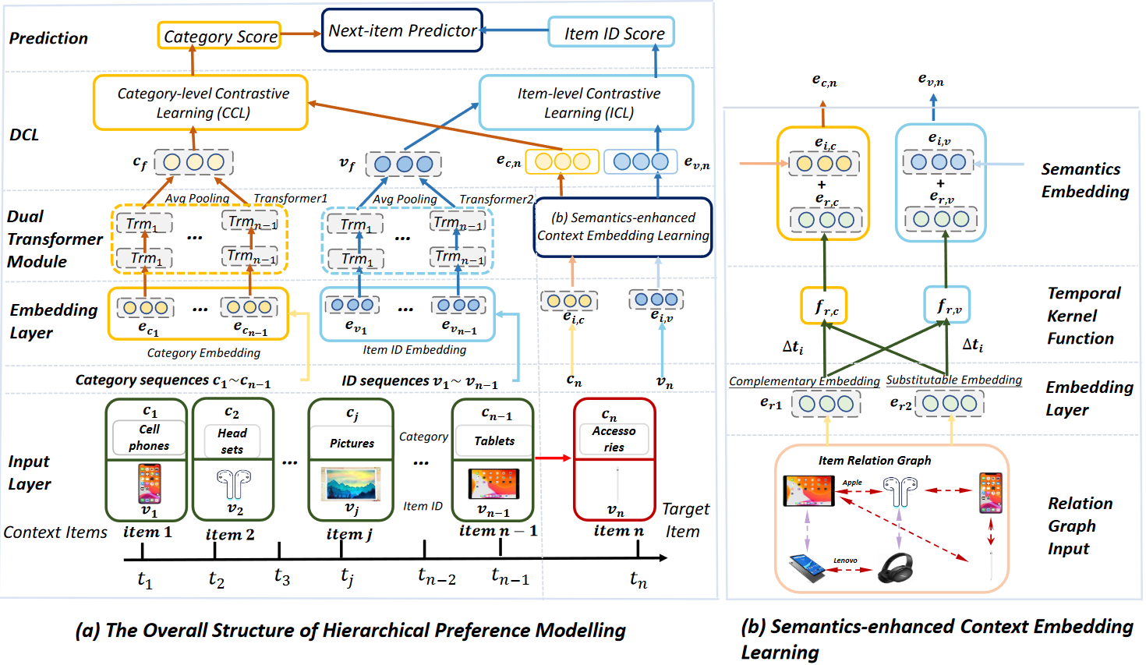
Method — Hierarchical Preference Modeling (HPM)

Slide 8
Method — Hierarchical Preference Modeling (HPM)

Slide 9
Problem Formulation
predict the next item ID $v_{n}$ of user
use sequential recommendation dataset as $\text{D}\text{ = \{}S_{1}\text{,} …,S_{i}\text{,} …, S_{n}\text{\}}$
$S_{i}\text{=<}O_{i}\text{,} v_{n}\text{>}$ means the unique sequence for user $u_{i}$
$O_{i}\text{=}\text{\{}V_{i}, C_{i}\text{, }T_{i}\text{\}}$ means the context information for user $u_{i}$
$V_{i} = \{v_{1}, v_{2}, …,v_{n−1}\}$ , $C_{i} = \{c_{1}, c_{2}, …,c_{n−1}\}$ , $T_{i} = \{t_{1}, t_{2}, …,t_{n−1}\}$
item ID sequence , item category sequence, timestamp sequence
$$S_{i}$$

Slide 10
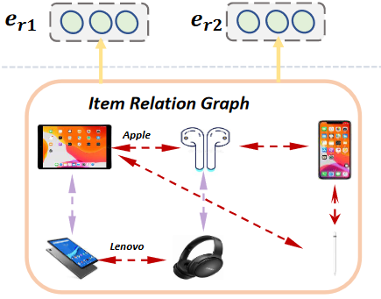
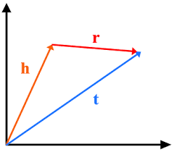
Embedding Layers
item ID embedding $e_{v}$、category type embedding $e_{c}、$
relation ID embedding $e_{r}$
use the classical TransE method to pre-train
(haed, relation, tail) x n
loss function of TransE 𝑓 (·)：

Slide 11
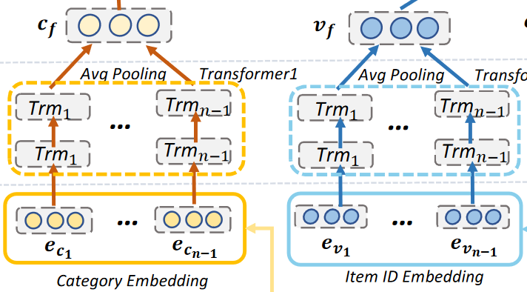
Dual Transformer Module
input ：category type embedding $e_{c_{i}}$、item ID embedding $e_{v_{i}}$
use multi-head self-attention and average pooling operation
output：
user category-level representation $c_{f}$、
user item-level historical representation $v_{f}$

Slide 12
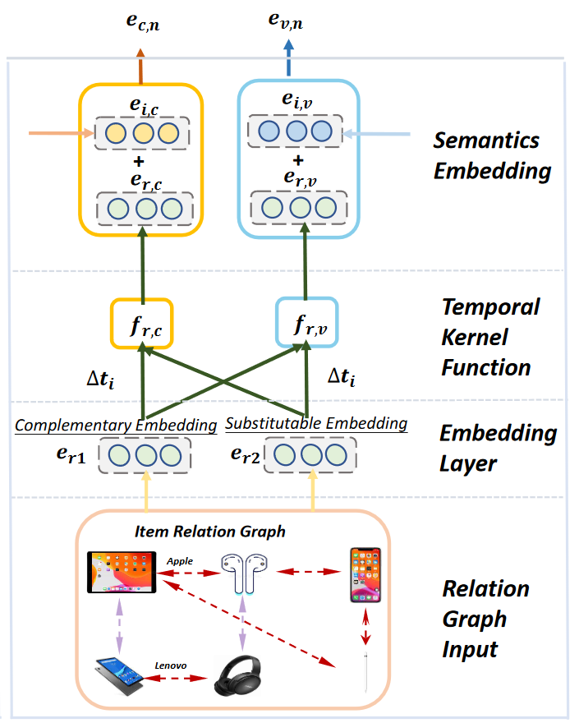
Semantics-enhanced Context Embedding Learning
enhance the connection between history items and target item
consider relationships and time

Slide 13
Relation Graph
use relations：also buy(co-purchased)、also view(co-clicked)、same brand、same category with similar price

Slide 14
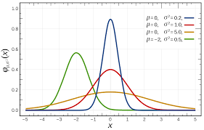
Temporal Kernel Function
complementary relations：
also buy(co-purchased)、same brand
substitute relations：
also view(co-clicked)、same category with similar price
Normal distribution

Slide 15
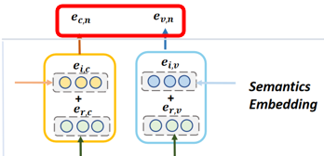
Temporal Kernel Function
history item has explicit relation with target item $I_{r}( )=1,$
otherwise, $I_{r}( )=0$
combine same relation item
combine difference relation
$$v^{′}$$
$$v^{′}$$
$$v^{′}$$
$$v^{′}$$
$$v^{′}$$
$$v^{′}$$
$$v$$

Slide 16
Dual Hierarchical Preference Contrastive Learning
contrastive learning loss：
Dual contrastive learning loss:

Slide 17
Loss Function

Slide 18
Experiment
Data Set
six representative sub-datasets from Amazon dataset
Evaluation Metric
Hit Rate
NDCG

Slide 19
Experiment

Slide 20
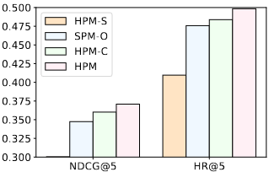
Experiment
Ablation Experiments
HPM-S: HPM without SCEL module
SPM-O: replace the dual transformer structure with a single transformer.
HPM-C: HPM without DCL.
Beauty
Sports

Slide 21
Conclusion
a novel dual-transformer module and a novel dual contrastive learning scheme to learn users’ low- and high-level preferences
a novel semantics-enhanced context embedding module to generate more informative context embedding

